Slide 1

Medical Murder is the #1 Cause of Death in the U.S. – By Design (People Are Too Expensive – Satan’s Big Lie)
Now What: Repent, Get Right with God, and Shine the Light You Have

Slide 2


Review – each of the six sections

Slide 3
Medical Murder is the #1 Cause of Death in the U.S. – By Design (People Are Too Expensive – Satan’s Big Lie)
Who? They’re All In On It!

Slide 4
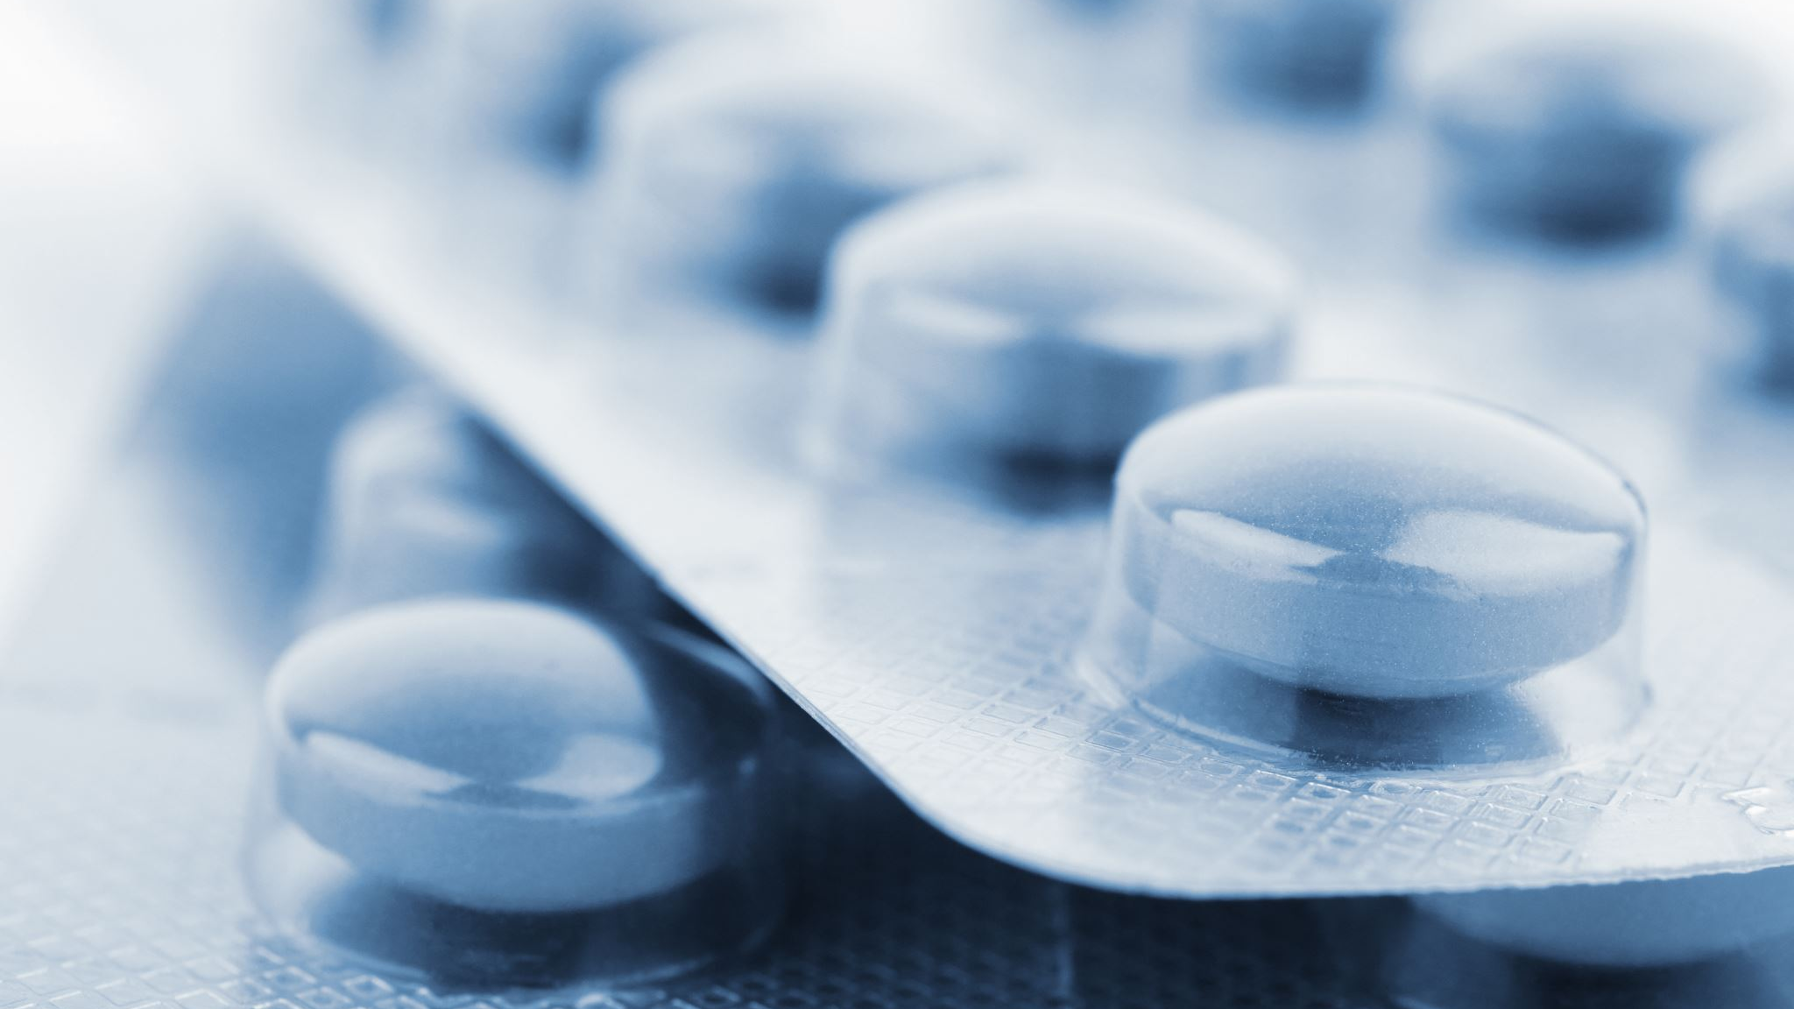
Medicine/doctors - worse than the politicians who legislated this nightmare https://www.bitchute.com/video/3LiWm7OaKPmX/

Slide 5


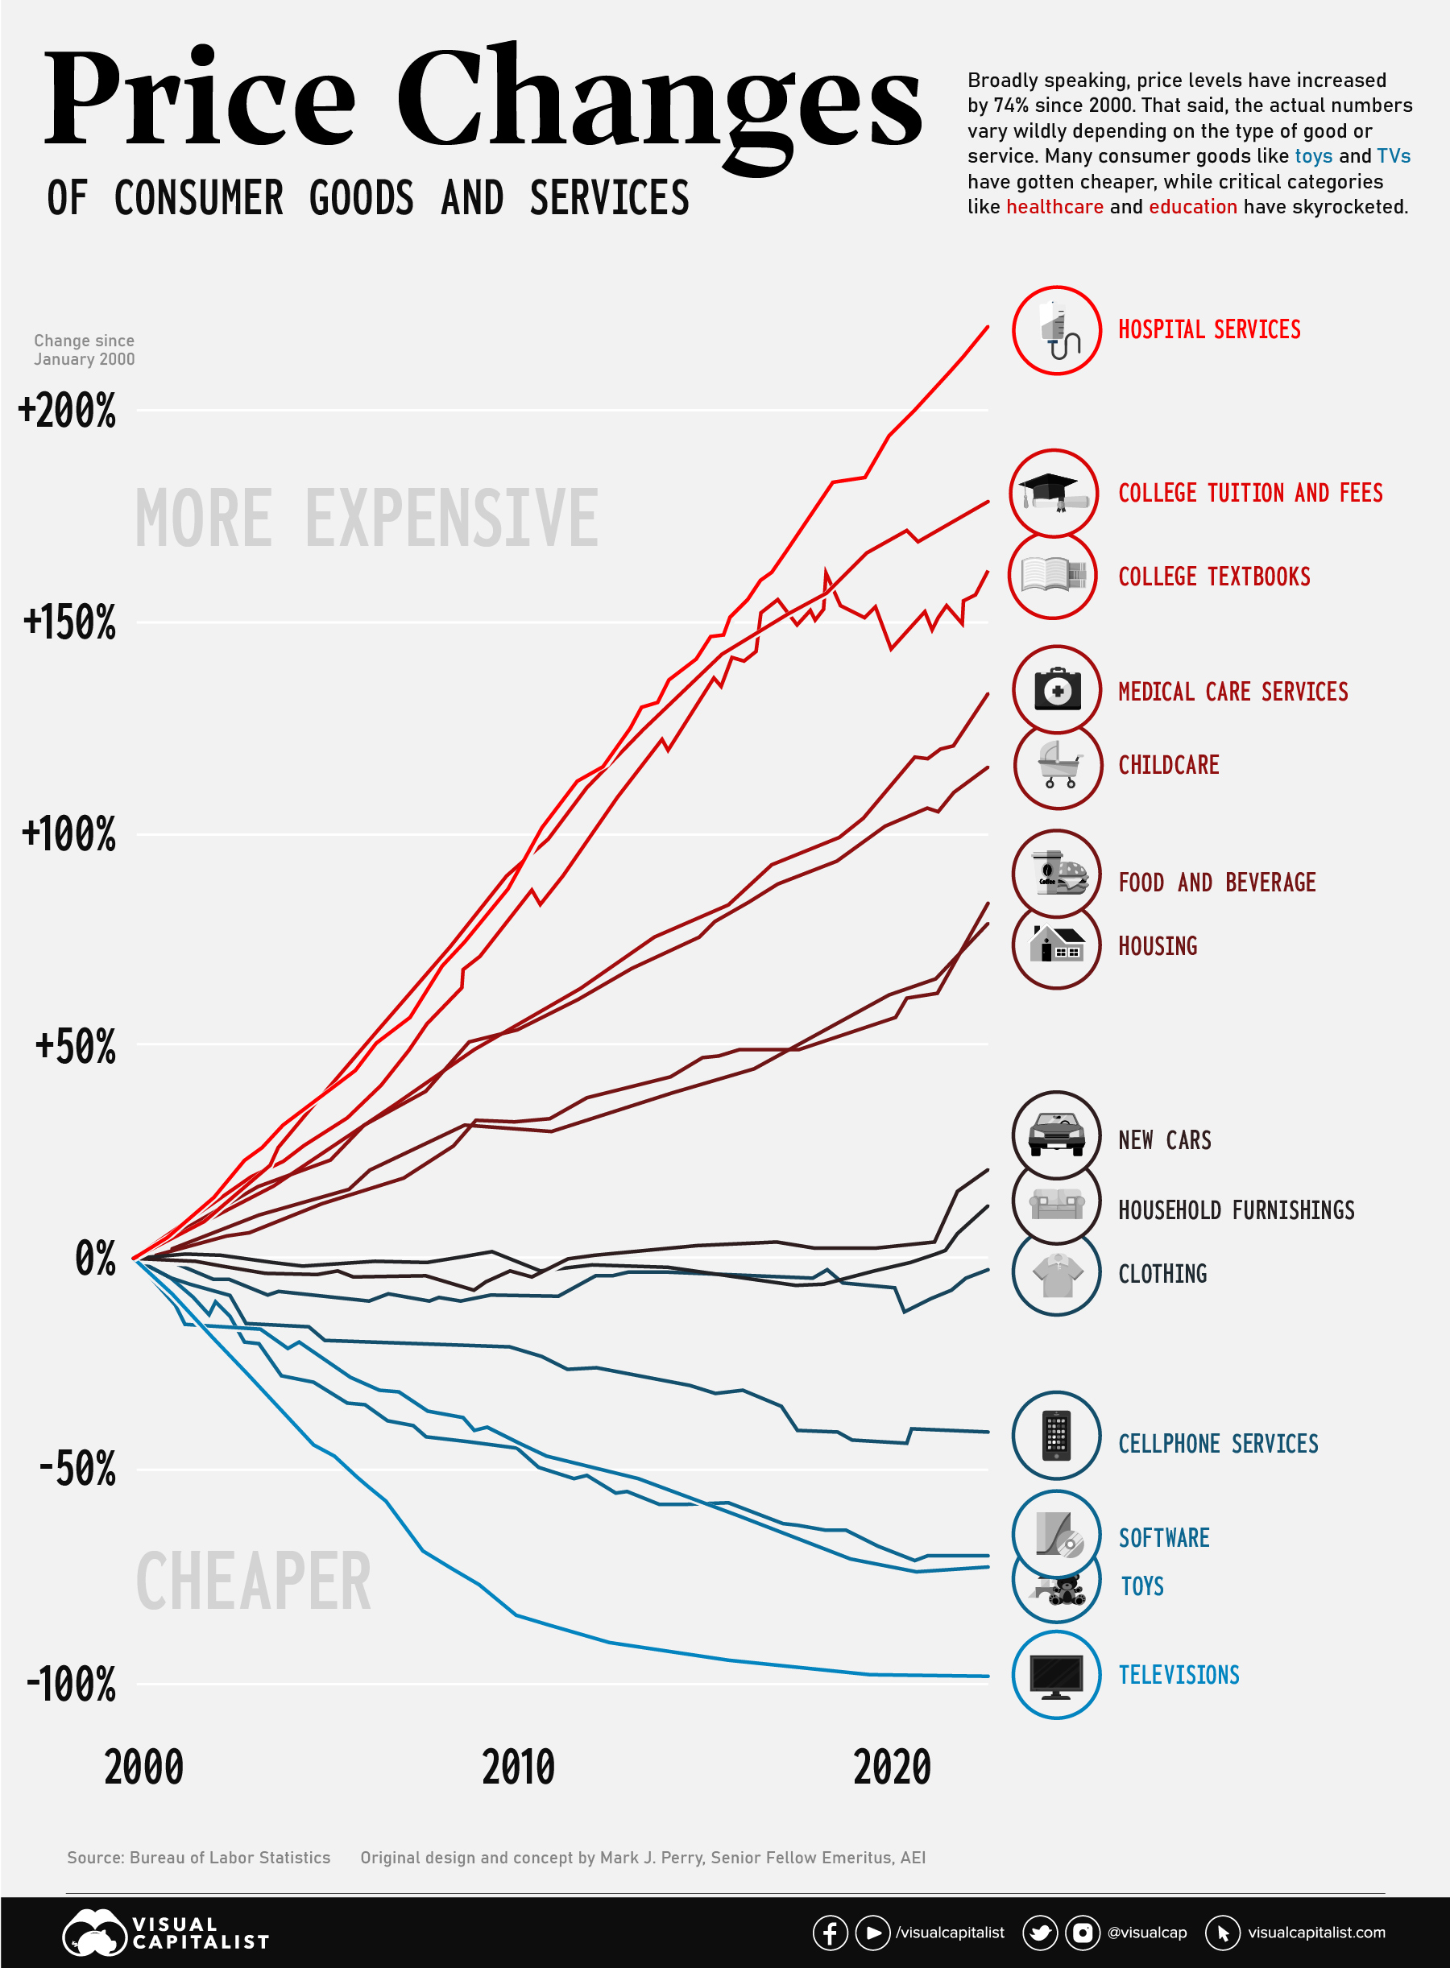
Follow the $$
Regarding medical murder, the focus is on blaming the system vs. realizing this is the goal. I receive comments about the system, regularly, from people who have lost loved ones. I tell them, “This is an example of how deep the lies we’ve been told, about the Hippocratic Oath and justice, have been embedded in our culture. What you experienced was not a failure of our system. It was a system designed this way, on purpose.”

Slide 6
Medical Murder is the #1 Cause of Death in the U.S. – By Design (People Are Too Expensive – Satan’s Big Lie)
What? The Culture of Death

Slide 7

What is Eugenics?
Eugenics: Excluding people and groups judged to be inferior or promoting those judged to be superior. “Survival of the fittest” has been proactively practiced since ancient times.
In one of Plato’s (died 348 BC) best-known literary works, The Republic, he wrote about creating a superior society by procreating high-class people together and discouraging coupling between the lower classes. He also suggested a variety of mating rules to help create an optimal society.

Slide 8
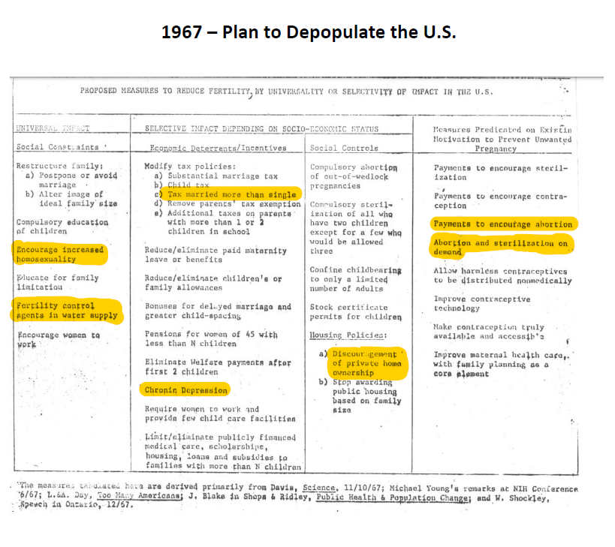
Plans to depopulation the U.S. were formalized in 1967 - Berelson and Jaffe would work together on the 1972 Rockefeller Commission Report

Slide 9
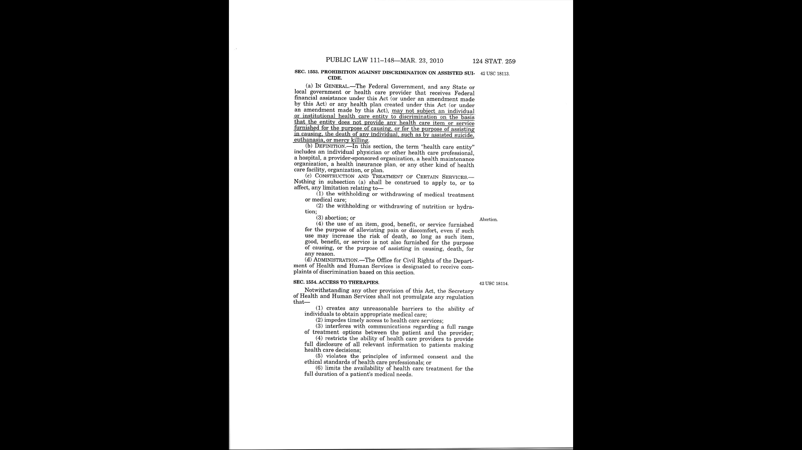

Slide 10
Medical Murder is the #1 Cause of Death in the U.S. – By Design (People Are Too Expensive – Satan’s Big Lie)
Where? Mystery Babylon

Slide 11
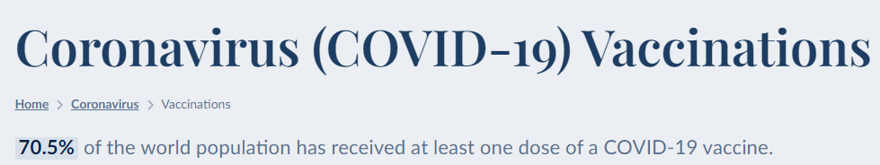
America leads the world astray
Revelation 18:23: For your merchants were the most important people of the earth, because with your pharmakeia they deceived all the nations.

Slide 12
Medical Murder is the #1 Cause of Death in the U.S. – By Design (People Are Too Expensive – Satan’s Big Lie)
Why? The Esoteric Spiritual Battle

Slide 13

What we are seeing has to be satanic
All the details, players, timeline, secret societies…; a coordinated effort over time.
Part of the battle for the souls of all men who don’t follow the God of the Bible. They follow the false light believing they will be saved by serving Satan’s anti-Christ system – they are all walking into the ultimate trap.
https://www.youtube.com/watch?v=rVWqVqNp4rw

Slide 14
Satan’s method: DECEPTION
Genesis 3:15 – God tells us that Satan’s role is a deceiver.
“And I will put enmity between you and the woman, and between your seed and her seed; He shall bruise your head, and you shall bruise His heel.”

Slide 15
Satan is permitted to afflict God’s people
The Patriot Movement
Believing that somehow God is going to save America, without repentance, is an example of Satan’s deception.
The Church
Is the current eschatology ‘position’ push a satanic dialectic?
https://www.youtube.com/watch?v=rVWqVqNp4rw

Slide 16
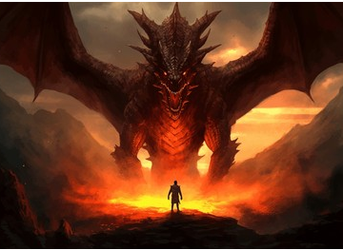
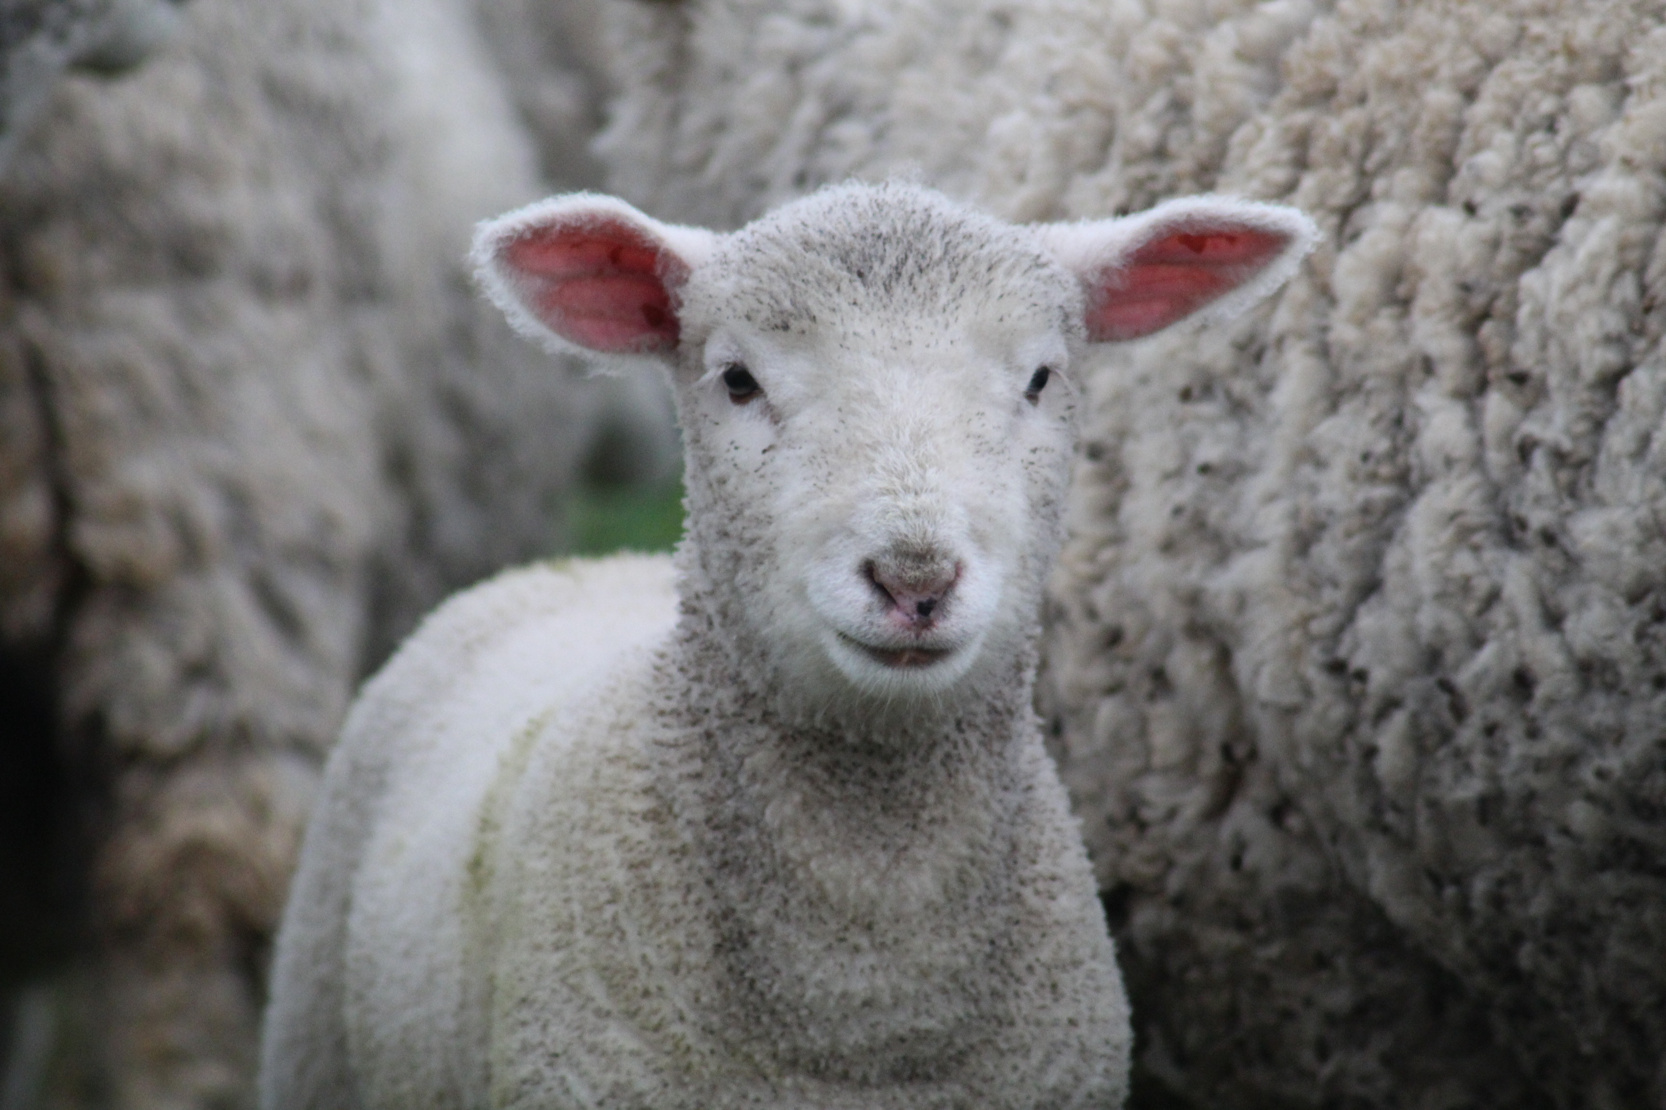
Most everything we see today fits into the two beast systems of Revelation 13
Race to expose evil – 1st beast (anti-Christ system)
Security and comfort – 2nd beast (false prophet system)

Slide 17
Medical Murder is the #1 Cause of Death in the U.S. – By Design (People Are Too Expensive – Satan’s Big Lie)
When? What Began in the Garden is on Steroids Today

Slide 18
Exoteric dialectics are traps used to blind us to the real agenda
Covid
Lab leak
Lies
Coverups
Lawsuits
Covid exposed the agenda but is not the agenda
President Trump
Election challenge
Lack of equal justice
Economic policies
Prayer in schools
https://www.bitchute.com/video/MYEgVPZF8Xsq/

Slide 19
Medical Murder is the #1 Cause of Death in the U.S. – By Design (People Are Too Expensive – Satan’s Big Lie)
How? The American Dream

Slide 20
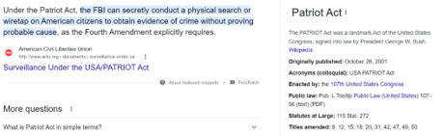
We made a bad trade – freedom for government protection
PATRIOT (BOHICA) ACT:
PROVIDING APPROPRIATE TOOLS REQUIRED TO INTERCEPT AND OBSTRUCT TERRORISM
411 = we are the terrorists!
https://www.bitchute.com/video/3LiWm7OaKPmX/

Slide 21
Conclusion: Look at Covid through the eyes of deception on an esoteric (evil being exposed, by design, to set up another evil) and exoteric level (you begin to see an amnesty play) – “we made a mistake, but we’ll do better next time.” Watch out for anyone who says Covid was a mistake. How is it possible we could fall for amnesty? Because of another big lie – people are inherently good (no one could be that evil) and our desire for security and comfort. Tom Renz promoting a Congressional investigation and Peter McCullough still calling the bioweapon a vaccine are examples. These are examples of being trapped in the exoteric dialectic. On the less evil esoteric agenda, there’s an exoteric push for Trump and all the fixes he says he’d bring – no wars; holding people accountable; gold backed currency; education overhaul; etc. – all an inversion of what we are experiencing today. What’s missing? Repentance. That’s our key to seeing the deception.
Covid was a success both esoterically (setting up the angel of light) and exoterically (created a dialectic to have us all focus on this evil while a substantially eviler agenda is taking place without being noticed). We are on the fringe – 80% of the people can be cut off from food, and electricity - the chaos level turned on in an hour for those especially in big cities (“Smart Growth” plan makes it easier to live in cities). That’s saying nothing about poisoning the water supply – and this is just what we know about. Digital currency is just a dialectic in this Satanic game.
Satan is the prince of this world, and the entire anti-Christ system is a trap to get us to put our faith in men and knowledge. The matrix was designed to enslave us. God used Grace’s murder to lead me out of the trap.
2 Chronicles 16:12: In the thirty-ninth year of his reign Asa was afflicted with a disease in his feet. Though his disease was severe, even in his illness he did not seek help from the Lord, but only from the physicians.

Slide 22

Now compared to other times in world history – will the U.S. be taken down?

Slide 23

Revelation 18:19 - for in one hour is she made desolate
https://youtu.be/zJoK5wngEL0?si=ko4xHEk_rB7ZN_lt

Slide 24

Satan knows the Bible better than any man and his days are numbered; hence the release of all kinds of evil setting up the great deception

Slide 25

God’s judgment is overdue
https://www.youtube.com/watch?v=zJoK5wngEL0

Slide 26

Chinese invasion?
https://www.youtube.com/watch?v=rVWqVqNp4rw

Slide 27
Conclusion: God’s judgment is deserved, is coming, and it will be swift. Satan’s announced plans are no surprise. It is urgent to get right with God.

Slide 28

Are we finally ready for God?

Slide 29
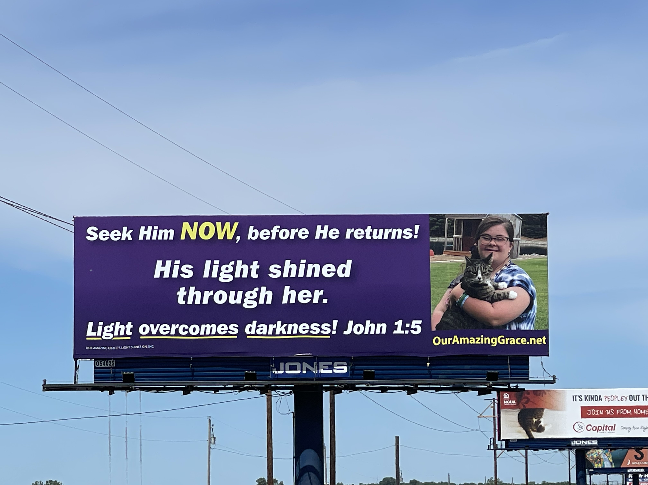
There are only two choices – either love self or love God
You have been Red Pilled; the American Dream was a lie. Now what? God wants you to choose to keep pursuing real truth, which is to escape the world’s matrix altogether; take the white pill – enter, then finish the race God is calling you to be in.
If you are now awake, you quickly conclude He is the only answer. You and no man (great leader) can protect you from this satanic system. Now what? A new paradigm – instead of gathering toys we store up riches in heaven; God has been chasing us, wanting us to conclude, as Solomon in Ecclesiastes 1:2 “Everything is meaningless” in Satan’s kingdom.

Slide 30
Step #1: acknowledge, believe and repent
Romans 1:20: For since the creation of the world God’s invisible qualities—his eternal power and divine nature—have been clearly seen, being understood from what has been made, so that people are without excuse
Romans 3:23: For all have sinned and fall short of the glory of God
Romans 6:23: For the wages of sin is death, but the gift of God is eternal life in Christ Jesus our Lord
John 3:16: For God so loved the world that he gave his one and only Son, that whoever believes in Him shall not perish but have eternal life
Ephesians 2:8-9: For it is by grace you have been saved, through faith—and this is not from yourselves, it is the gift of God— not by works, so that no one can boast
God’s nature is plainly seen, and He seeks a relationship with us. He creates a desire in our heart so we can see who we are and who He is. We now have a choice. What does God want our answer to be when coming to grips with who we are? Acknowledge, Believe, and Repent. We are now born again and in right standing with the Father; Jesus paid the penalty of our sin; God declares us righteous!

Slide 31
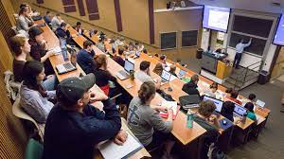
Now what? The real work begins…
Our stumbling block is pride. How do we become humble?
https://www.youtube.com/watch?v=C-1BzkHqD2g

Slide 32
Conclusion: Jesus said, “Repent of your sins and turn to God, for the Kingdom of Heaven is near.” (Matthew 4:17). Jesus said, “I am the way and the truth and the life. No one comes to the Father except through me.” (John 14:6). God resists the proud but gives grace to the humble. (James 4:6). To be useful to God in this world requires walking with Him continually.

Slide 33
Physical and Spiritual Preparation
Genesis 50:20: You intended to harm me, but God intended it for good to accomplish what is now being done, the saving of many lives
Grace was a casualty of war for a time such as this (Esther 4:14)

Slide 34
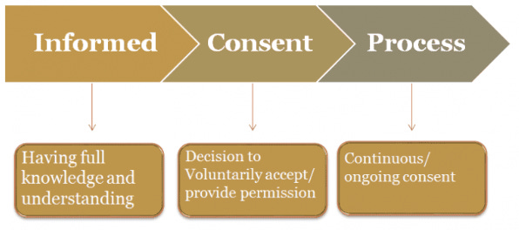
Physical = protecting yourself = change your belief Why do non-hunters own a gun?
Advocacy
Informed Consent
Medical Directives

Slide 35
Discern Agenda 2030 Control Grid
Former Assistant Secretary of Housing and Urban Development, Catherine Austin Fitts, discussing the push for CBDC complete control system
https://www.youtube.com/watch?v=iK5V89fU61Y&t=1593s&pp=2AG5DJACAQ%3D%3D
Alex Newman comments about demonizing cash and not crossing the CBDC line
https://rumble.com/v3hn810-whos-behind-the-shadow-government-alex-newman.html
Sylvester Stallone’s opinion
https://youtube.com/shorts/qs-oUX5ULo8?feature=shared

Slide 36
Spiritual Perspectives and Actions - Introduction
Gaining wisdom
https://www.youtube.com/watch?v=GuPZ5nAFjVc
What should we be doing?
https://www.youtube.com/watch?v=rVWqVqNp4rw

Slide 37
More actions to consider…
Diedrich Bonhoeffer – “Not to speak is to speak; not to act is to act.”
Occupy - We are called by God to occupy until Jesus returns. That means we stand up for the TRUTH and call evil out for what it is.
Roots – why do people succumb to the pressure to purchase a timeshare? “I would never do that” – are you sure? How do you know? How will you handle if “required” to bow down? Shadrach, Meshach and Abednego showed us what to do. Fear is a great motivator to accept security and comfort which has become our idol.
Will our normalcy bias have us be unprepared? Walk through and discuss things with your family.
https://www.youtube.com/watch?v=rVWqVqNp4rw
What did Jesus say to Satan when tempted? Matthew 4:8 – 11: Again, the devil took Him up on an exceedingly high mountain, and showed Him all the kingdoms of the world and their glory. And he said to Him, “All these things I will give You if You will fall down and worship me.” Then Jesus said to him, “Away with you, Satan! For it is written, ‘You shall worship the Lord your God, and Him only you shall serve.’” Then the devil left Him, and behold, angels came and ministered to Him.

Slide 38

Basic checklist
Trust in God’s promises
Put on the full armor of God
Shine the light you have
Don’t participate in evil
Critically think before acting
Pray for God’s purpose
God did not give us a spirit of fear – don’t act on fear
Shine light on evil – don’t be afraid to speak out

Slide 39
More to consider…
Ephesians 5:11: Have nothing to do with the fruitless deeds of darkness, but rather expose them. Parable of the Talents (Matthew 25:14 – 30).
https://rumble.com/v3hn810-whos-behind-the-shadow-government-alex-newman.html
Stand firm. A definition of faith: Obedience to God in spite of the perceived consequences.
https://www.youtube.com/watch?v=YRjKORU5Z88&lc=UgyE46PHAUaUaHxLsGF4AaABAg

Slide 40
Conclusion: Stand firm. Be prepared. Get engaged. Stop waiting for someone else. If you witnessed a murder, what is your responsibility? What about a drive by shooting? Would you rest, or take action, until the person was arrested? Caleb and Joshua knew God would give them the victory if they trusted in God’s promise. Regarding preparation, Chuck Missler: there’s two mistakes you can make with preparing…failing to prepare and relying on your preparations. You rely on the finished work of Jesus Christ.

Slide 41
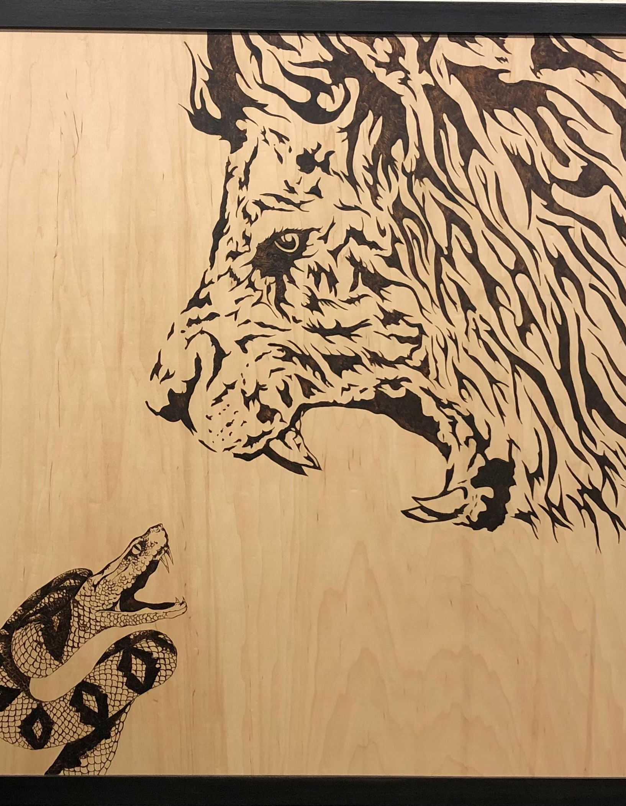
Have the confidence that only God can give
If God is for us, who can be against us? (Romans 8:31)
The God of peace will soon crush Satan under your feet. (Romans 16:20)

Slide 42

Final Thoughts…
Have faith that the worst thing that could happen God will use for His glory.
What’s the worst thing that has ever happened? Christ crucified
What’s the best thing that has ever happened? Christ crucified
Jesus said, “You are either with me, or against me”. (Matthew 12:30) What side will you be on?
As Grace would say, “God’s got this, dad.”

Slide 43
Medical Murder is the #1 Cause of Death in the U.S. – By Design (People Are Too Expensive – Satan’s Big Lie)
Thank you!

